Slide 1
Unwrapping the Gift: Benefits
of Computer Technology
Lecture 1
Syada Tasmia Alvi
Lecturer, Dept.of CSE
Daffodil International University

Slide 2

The Ubiquity of Computers and the
Rapid Pace of Change
Have you used a computer today?
You have if you used…
an ATM,
a cell phone,
music player (iPod)
a modern appliance, or
an electronic device.

Slide 3
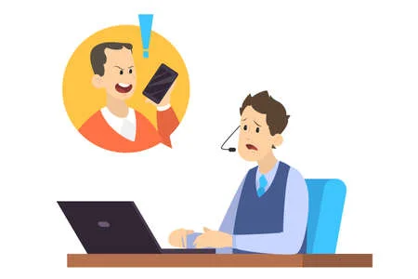
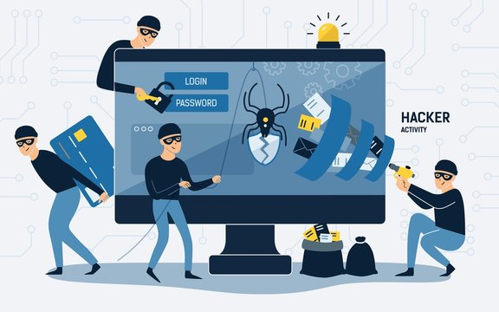

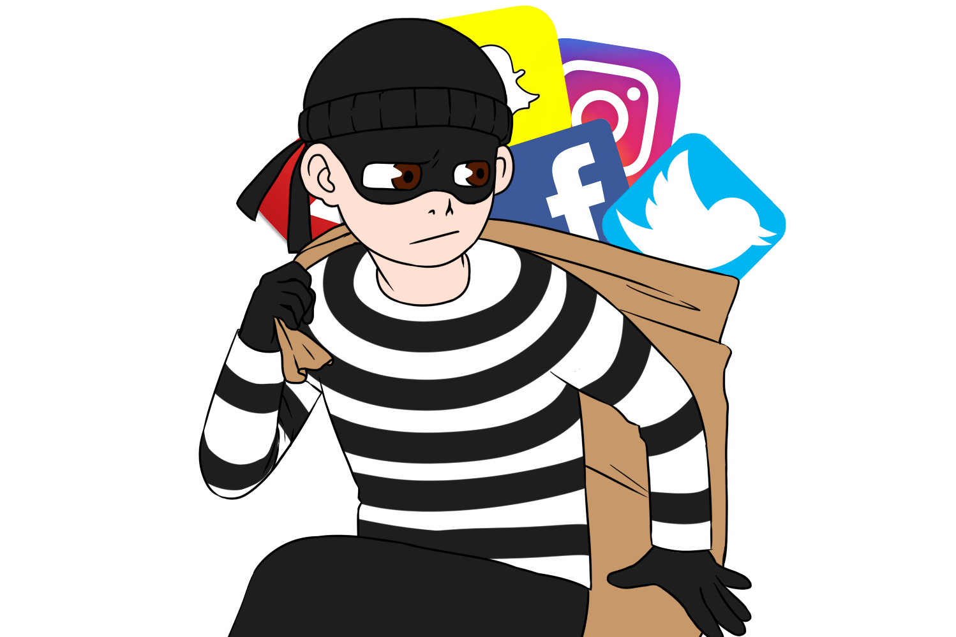
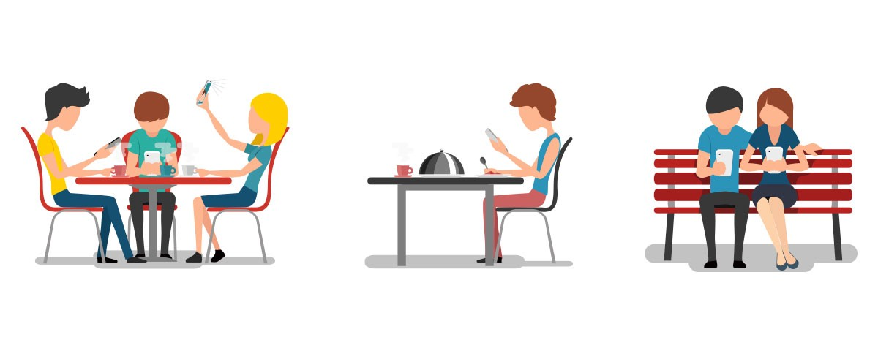
Negative impacts of new technology
Unemployment
Poor customer service
Crime
Alienation
Loss of Privacy

Slide 4
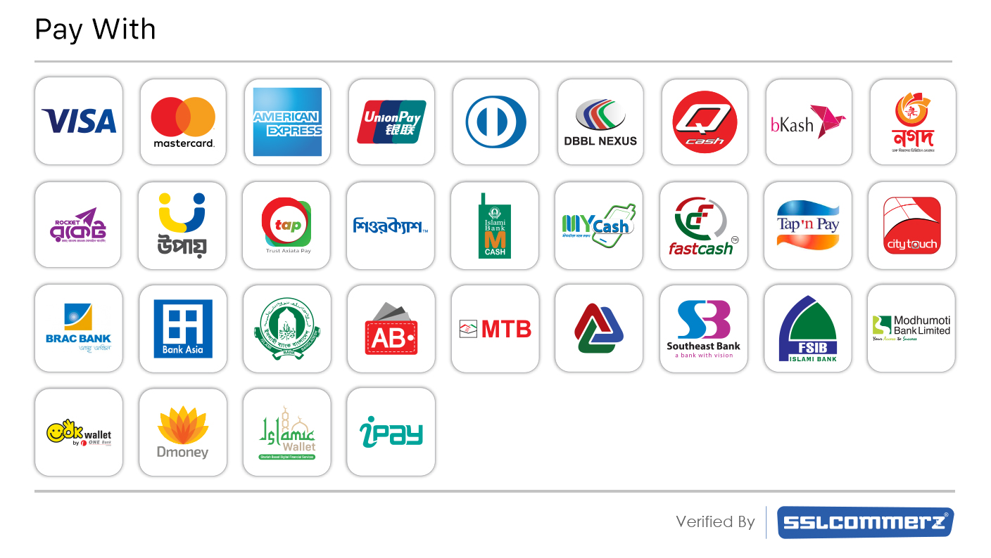

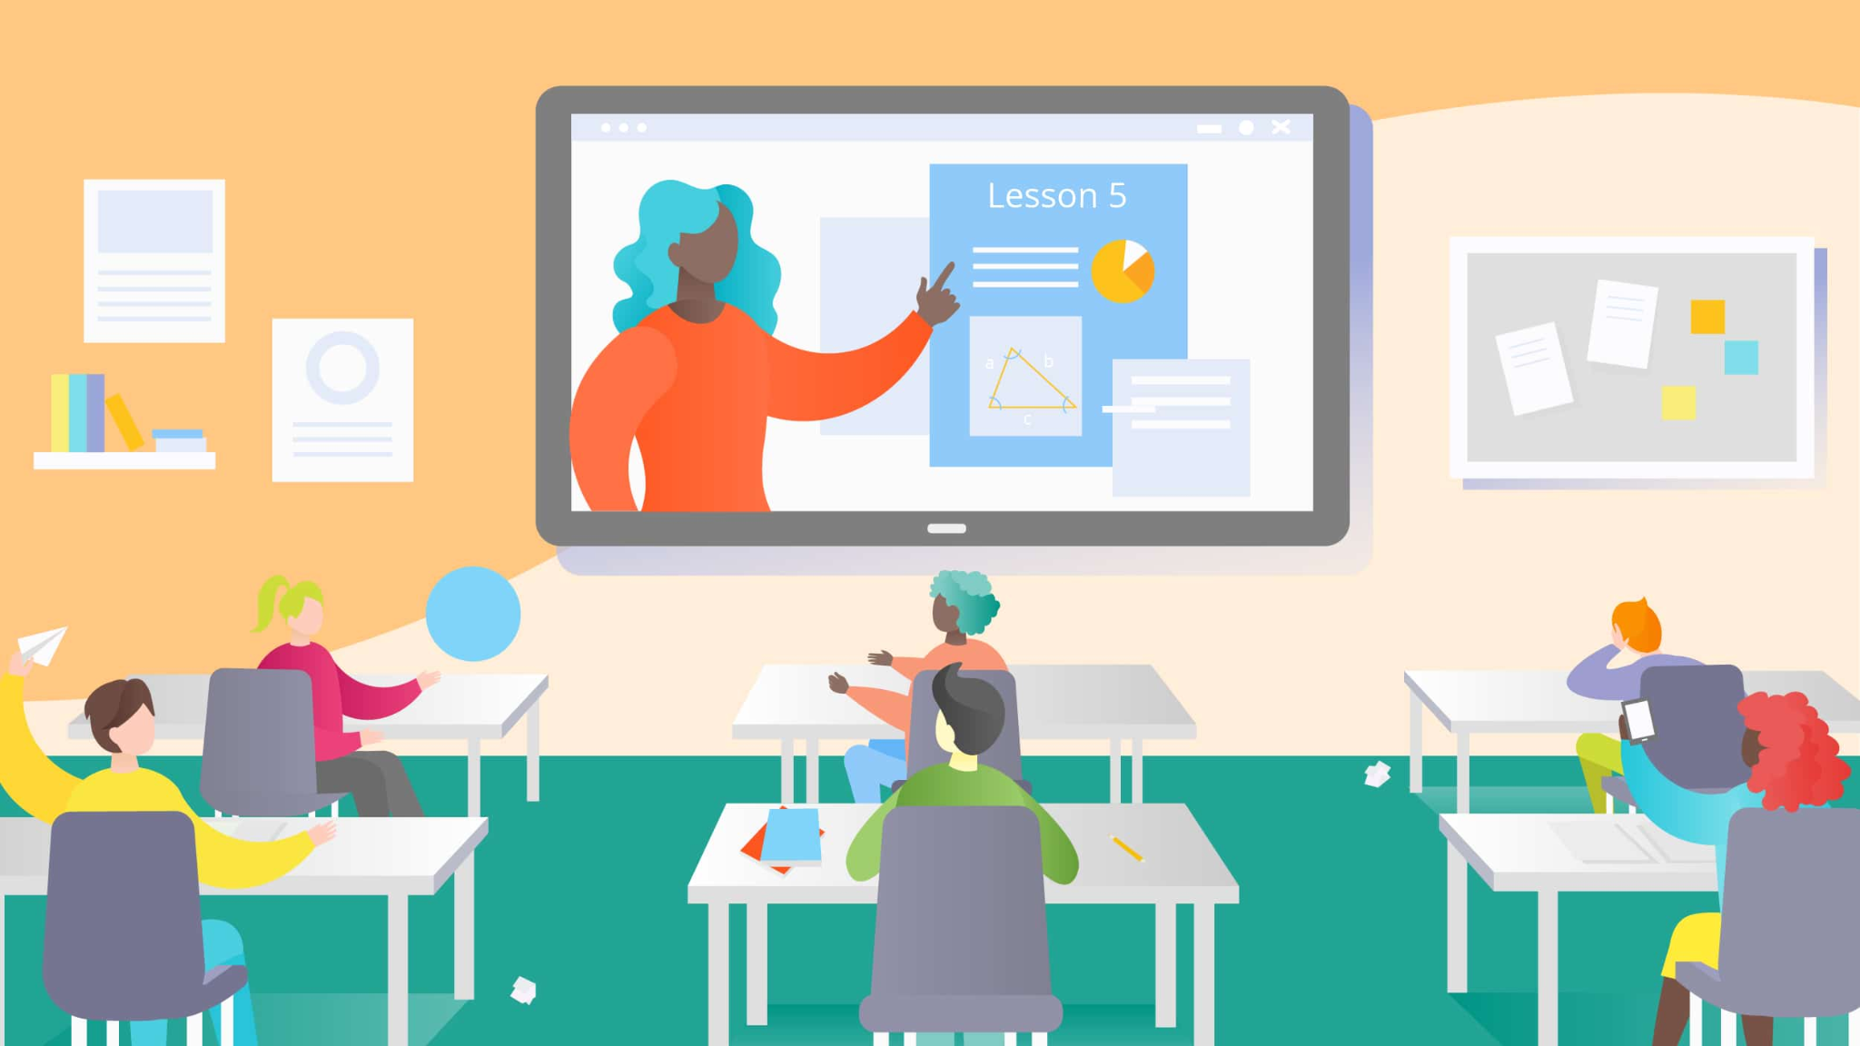
Some Positive Impacts of New Technology:
Convenience/ less effort
New types of jobs.
More options for transactions

Slide 5
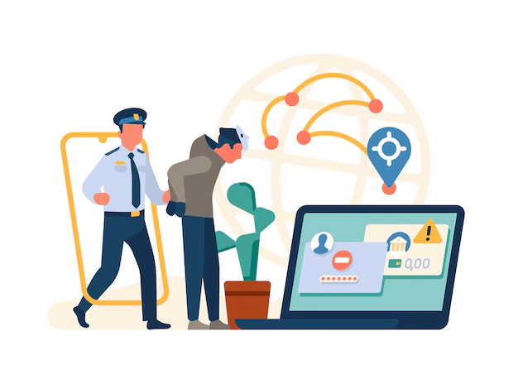
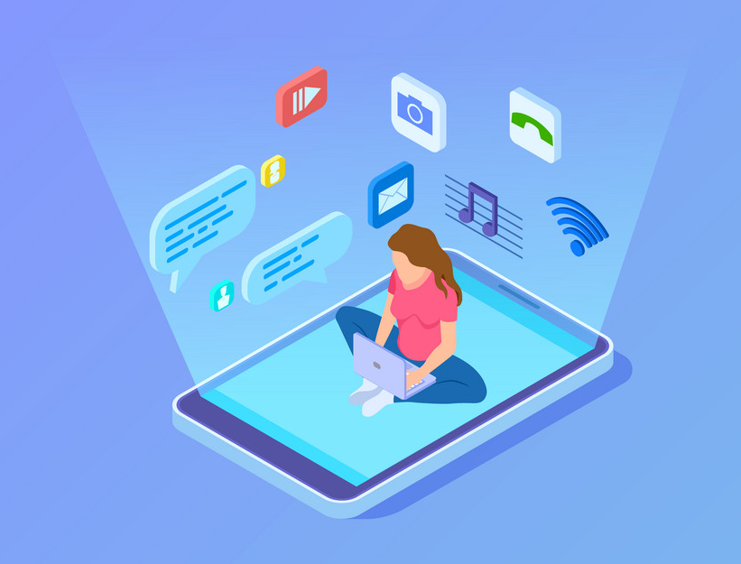
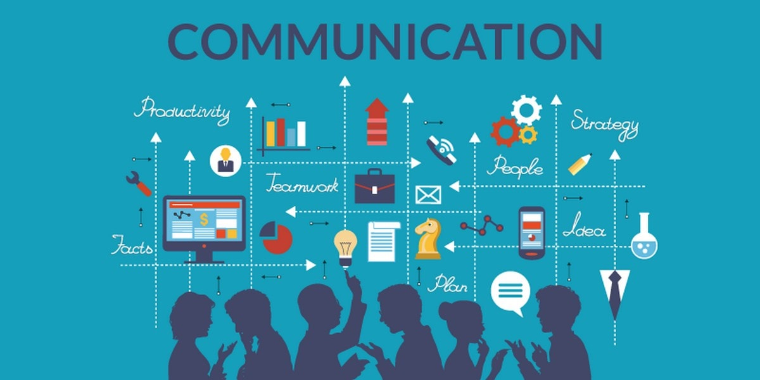
Some Positive Impacts of New Technology:
Improvements in crime-fighting.
New forms of entertainment
New ways to communicate

Slide 6
Appreciating the Benefits
1. Benefits computers bring to communication.
2. Benefits computers bring to transportation, especially within our communities.
3. Benefits computers bring to education and training as they aid local schools.
4. Benefits of computers in fighting crime.
5. Benefits computers bring to medicine.
6. Benefits computers bring to the disabled in schools and the workplace.
Notes:
Software company-> Sql injection attack

Slide 7

Benefits to communication
Non-invasive; read at recipients’ convenience .
Time-saving
Access to immense (often timely) amounts of information
Information on WWW can be in different formats such as text, graphics, video or sound.
Much information on the web is “free” and can be accessed by all.
Public forums not limited to geographic boundaries
Traditional boundaries are no obstacle
More independence - people can do more themselves –
Remote access available

Slide 8

Benefits to Transportation
Navigation : Prevent from getting lost
Diagnostics - e.g. chips that collect information about engine behaviour
Safety : Anti-lock Braking System and Truck roll-over prevention
Hybrid engines-New technologies, such as a warning system that alerts the driver he/she is veering off the road and at the same time corrects the drivers steering.
Fuel efficiency
Traffic pattern studies

Slide 9

Benefits to Education
Language acquisition - Teach people to speak a foreign language
Spelling
People who are illiterate can learn in the comfort of their own home, without feeling embarrassed.
Distance learning- . Students can learn and be taught from their own home without actually going to a school. (ex. Rural children unable to attend school due to distance or money)
Simulations : Help train people to do a specific job.
Speech recognition & synthesis (e.g. for learning a foreign language)

Slide 10
Benefits in fighting crime
Improved crime reporting (e.g. information about stolen art may be posted)
Faster search of arrest records and fingerprint files
Remote access to records and reports (e.g., from patrol cars)
Fingerprint matching has become easier with the introduction of there computer networks and databases. This task, as well as others, have become less time consuming and less painstaking
Access to numerous databases
Improved monitoring and surveillance equipment

Slide 11
Thank You

